Slide 1

Chapter 6
Employee Benefits

Slide 2
Employee Benefits
Employee Benefits: includes all compensation other than hourly wages

Slide 3
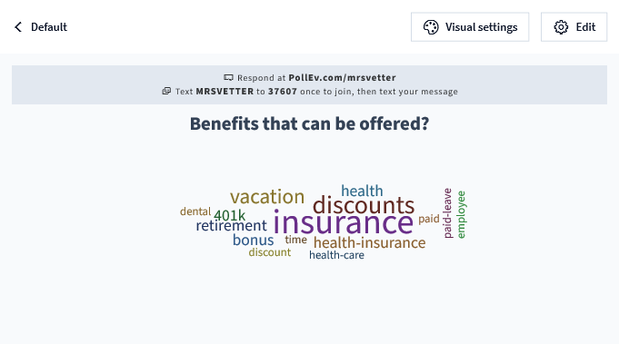
What kind of benefits are offered?

Slide 4
Employee Benefits
Employee Benefits: includes all compensation other than hourly wages
Many benefits beyond a paycheck are offered to full time employees
Some Parttime employees -
Companies compete for employees w/ benefit and incentive packages
Can add an additional 20%-28% more to your wage

Slide 5
Two Employee Benefit Classifications
Statutory Benefits
Discretionary Benefits

Slide 6
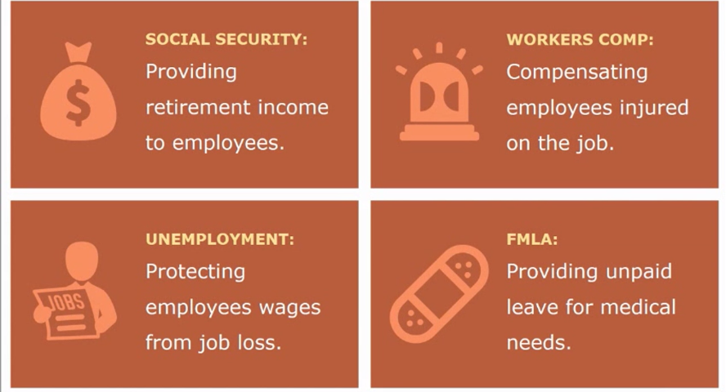
Statutory Benefits
Mandatory or required to give by law

Slide 7
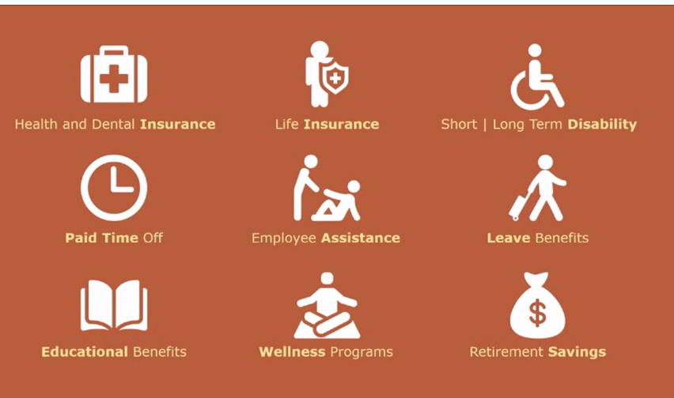
Discretionary Benefits
Voluntary or optional – part of employment package

Slide 8
Go to Google Classroom and Complete the Ed Puzzle.
Must be completed this hour.

Slide 9
Insurance Coverage

Slide 10
Health Benefits
May offer medical, dental, or vision –separate packages
Employers can pay all or some of monthly premium.
Can cost $600 or more a month, employer pays $500, you pay $100
Normally 50% or more
Taken out pretax
Can be for just the employee, or for employee plus family
May have deductibles and copays:
Copay - is a fixed amount a healthcare beneficiary pays for covered medical services before each appointment ($25.00)
Deductibles – amount you must pay out of pocket before the plan covers any expenses. ($250)
Coverage pays for a percentage of your bill. Ex: 80%

Slide 11
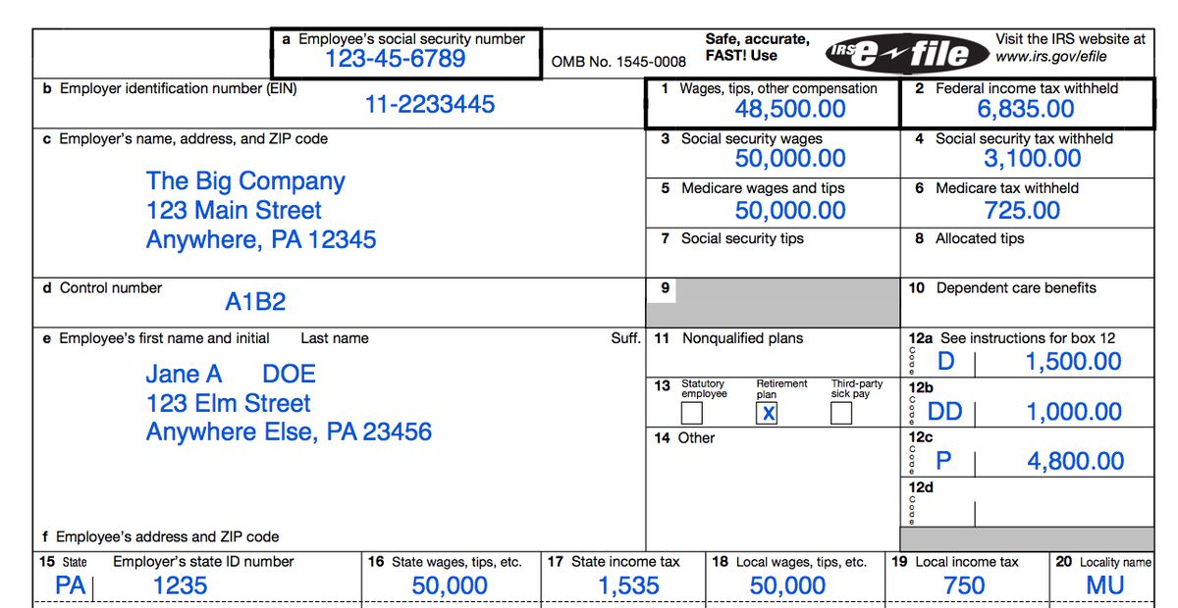
Box 3 = your gross wage Box 1 = your taxable gross wage - retirement funds like 401k, IRAs, medical premiums, flexible spending accounts and other deductions can reduce your taxable income

Slide 12
Types of Leave

Slide 13

Leave Benefits
Types of Paid Leave Benefits
Holiday Pay
Vacation Pay
Sick Pay
Bereavement

Slide 14

Holiday Pay
Holiday Pay = is a gift to employees so they can take time off without losing wages on legal holidays
Hourly Employees:
Not required to pay you on a legal holiday
If however, you work a holiday, it is required to be paid, however, it doesn’t have to exceed the employees’ normal pay rate
Sometimes, employers give (gift) 2 X hourly pay or 1.5 X hourly pay if an employee works on a holiday, not required by law.
Salaried Employees
Paid the full weekly salary, can’t reduce their salary for a holiday
Don’t have to pay extra if work on a holiday

Slide 15
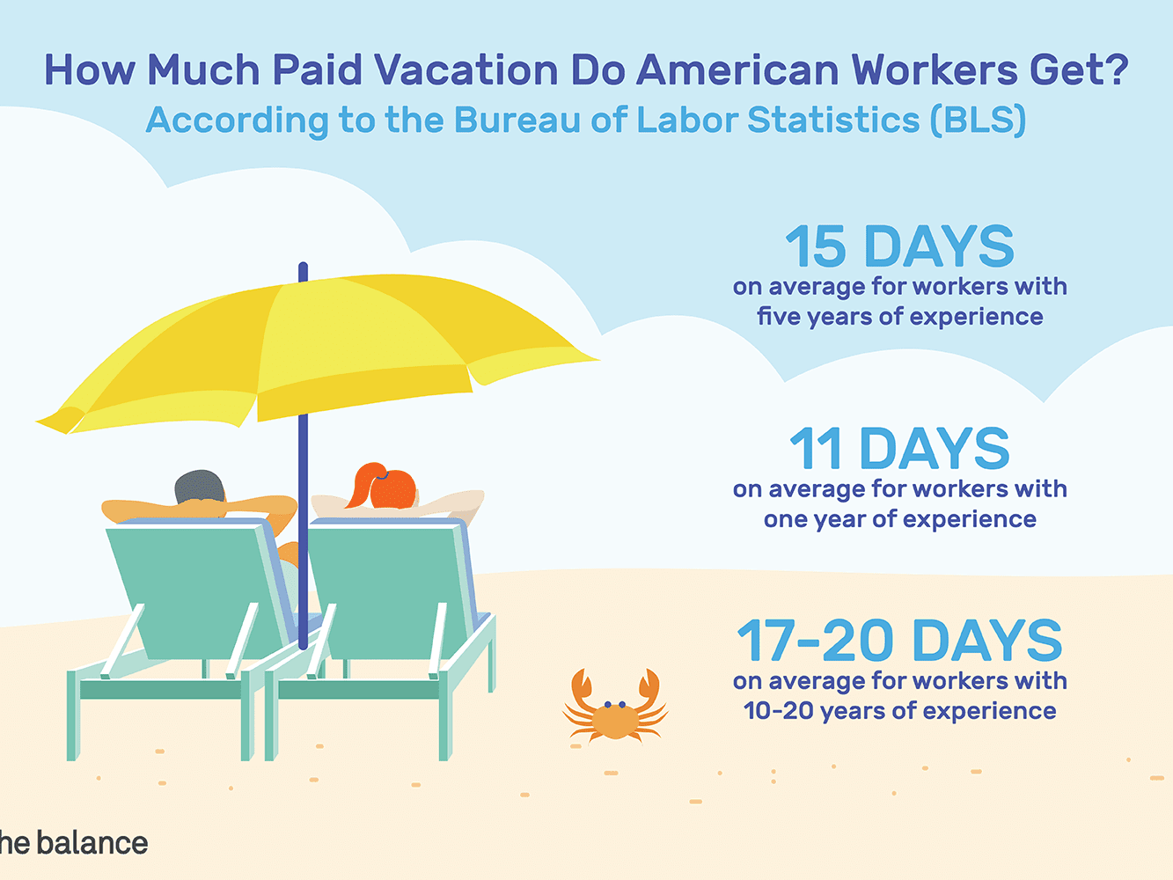
Vacation Pay
Vacation Pay = earn your regular wage while on vacation
Employers are not required to pay employees paid vacation time
Most companies offer vacation pay to be competitive in recruiting, increase employee morale and minimize turnover rates.
Often paid to full-time but not part time workers
Often earn more hours the longer you work there
When you quit, you may get paid for unused time

Slide 16

Sick Pay
Sick Pay = paid regular wage when you miss work due to illness
employer optional and employer defined
Ex: 6 days a year, 4 hours a month, or 1 day per month
When you quite, you do not get paid for unused hours

Slide 17
Bereavement – several days, usually up to 5 a year, for the death of an immediate family member
such as spouse, parent, or child
Sometime an aunt or uncle
Number of days is based on relationship. Ex: 1 day for an aunt, 5 days for a spouse
Does not reduce your vacation or sick time

Slide 18

PTO Pay
PTO – Paid Time off provides a bank of hours in which the employer pools sick days, vacation days, and personal days all in one.
Allows employees to use as the need or desire arises
One bank of hours for all types of pay except holiday
Usually can not carry over at the end of the year
If you don’t use it, you lose it

Slide 19
Retirement Benefits
403 K
401K
Traditional Roth
Roth IRA

Slide 20
Assignment
Access the Types of Retirement Accounts assignment in Google Classroom.
Research the four types of Retirement accounts listed
List 3 – 4 key points about each in the correct column in the assignment along with the URL from the article you used.

